Slide 1
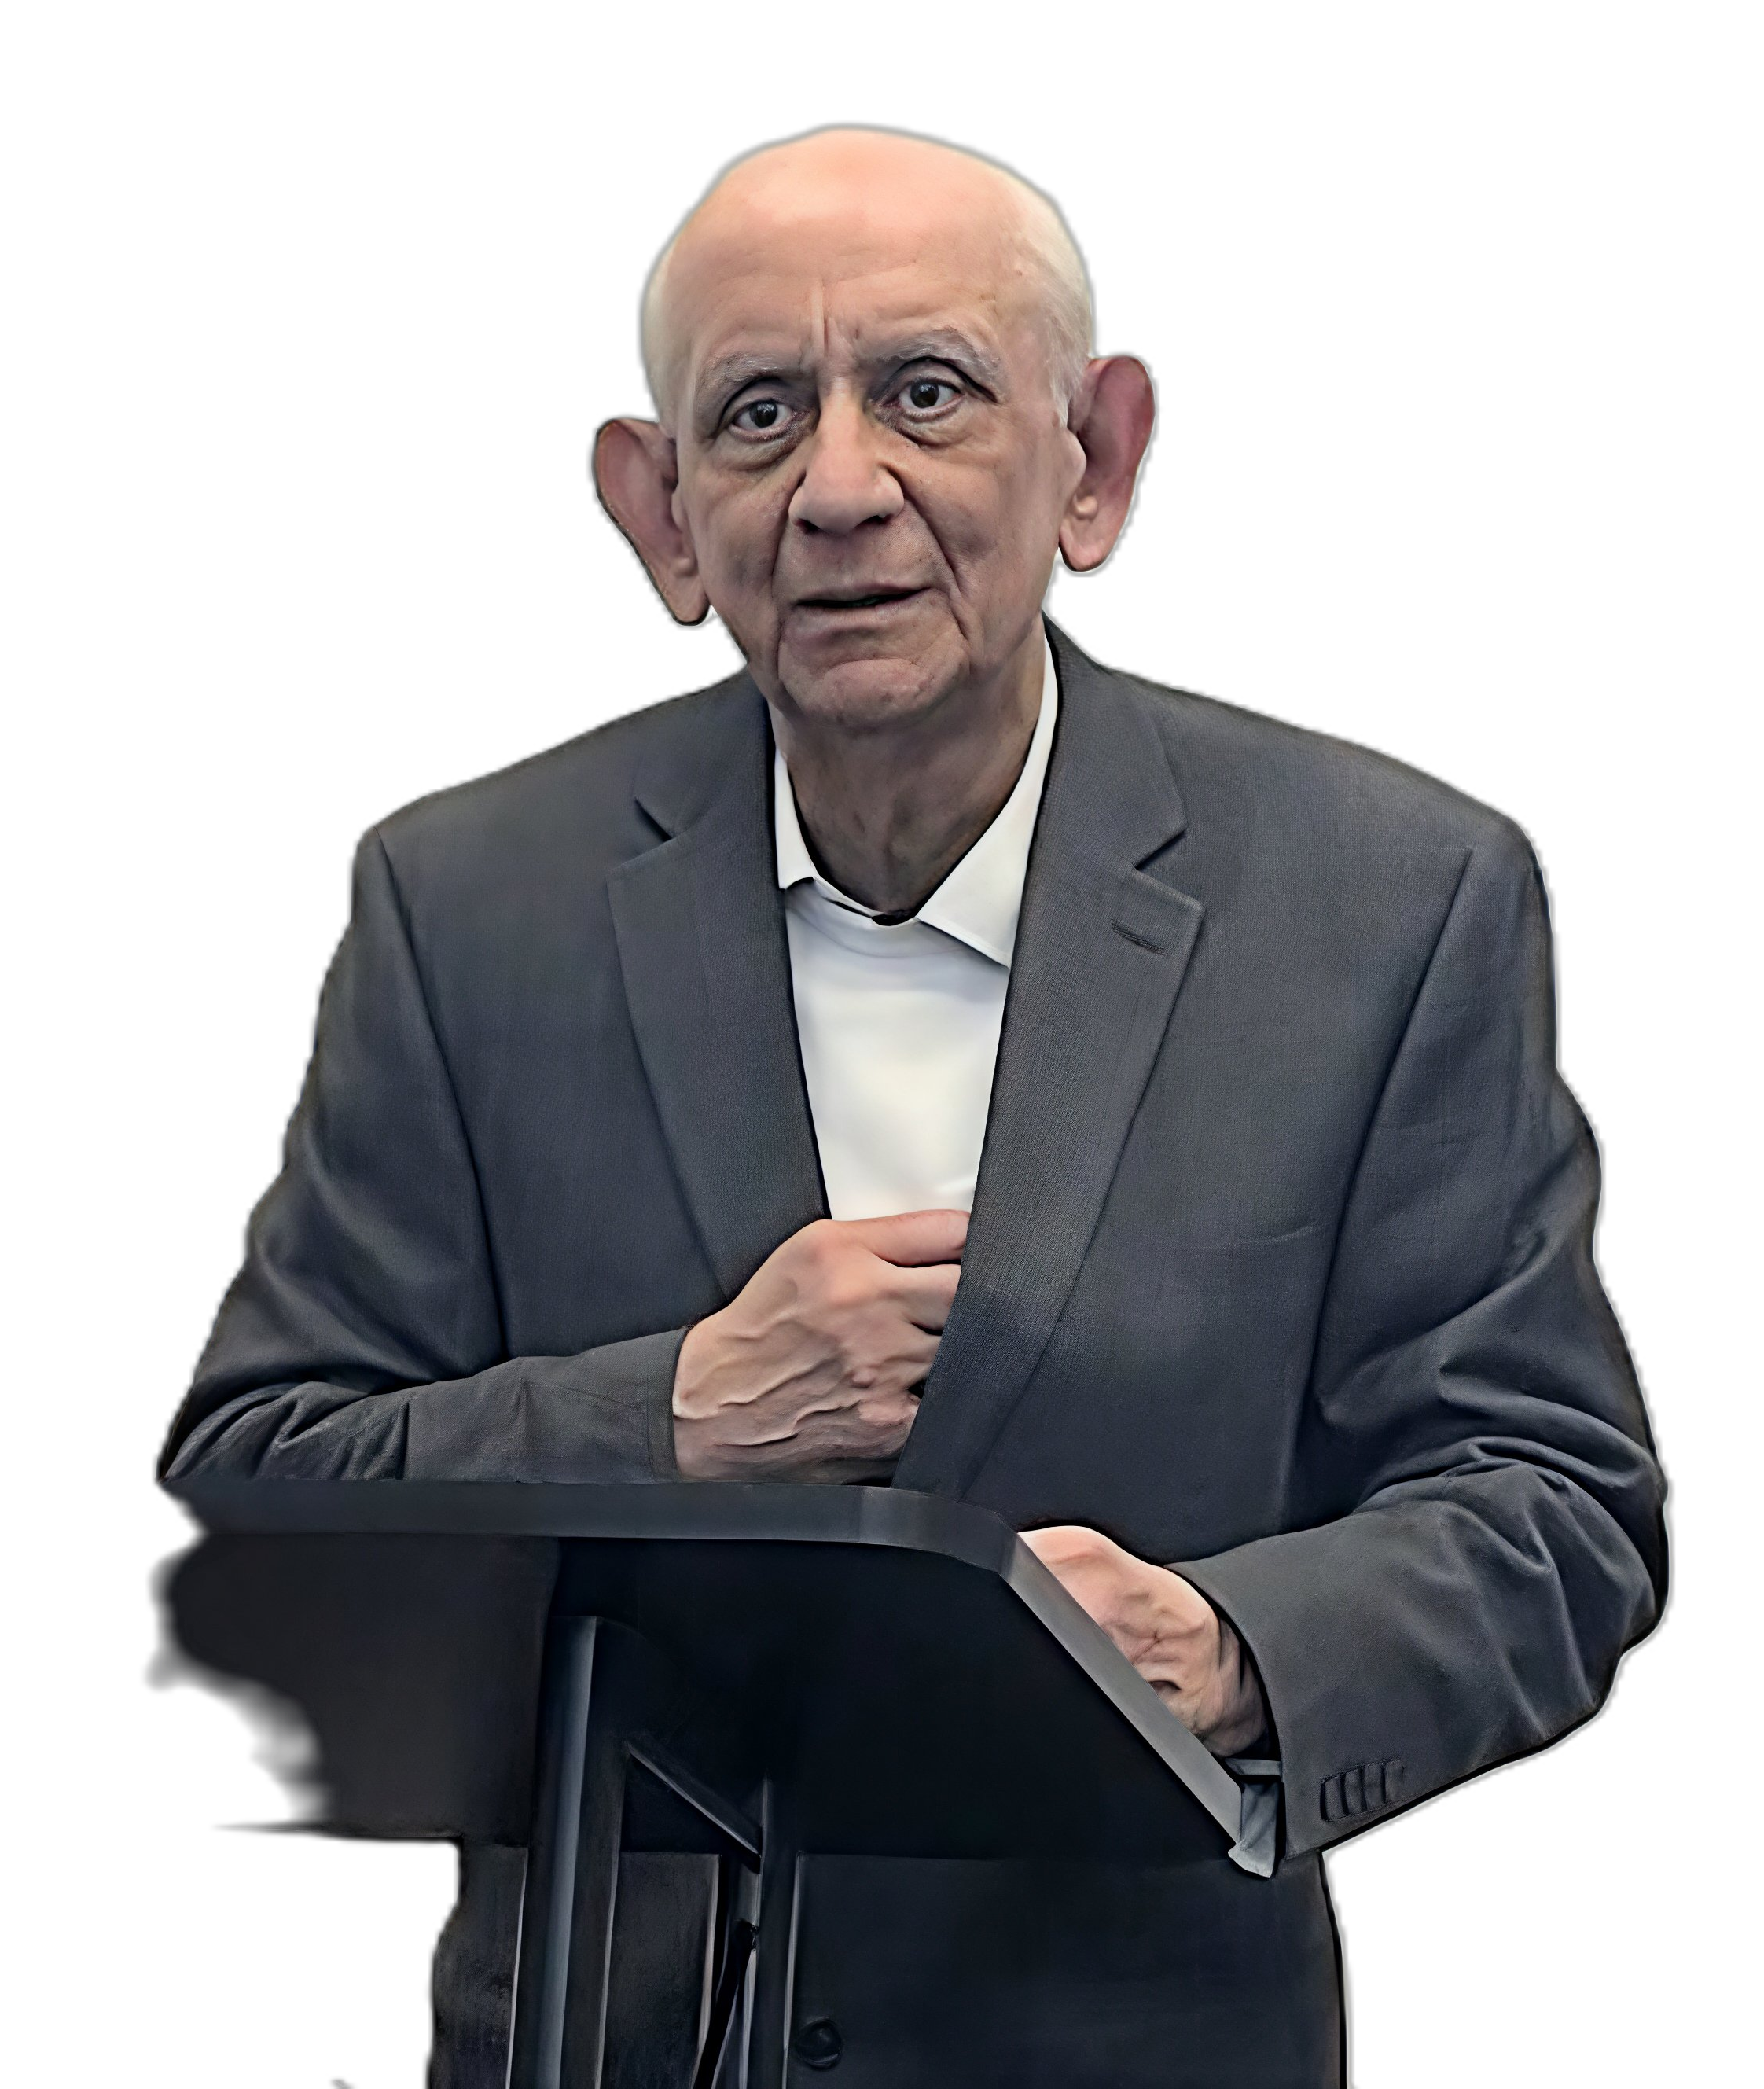
80th Birthday International Symposium for Prof. K.A. Padmanabhan
An online international symposium will be held in honor of Prof. K.A. Padmanabhan on the occasion of his 80th Birthday to recognize the impact of his work on the fields of materials science and engineering
Date : 6th April 2026
Time: 19.00 to 23.00 hrs. (IST)
Venue : Online Mode
Time zone: Asia/Kolkata
Google Meet joining info
Video call link: https://meet.google.com/wbn-aayv-rvv
Technical talks – 19.00 – 22.00 hrs.
S.No | Time | Speakers
1. | 19.00 – 19.30 hr | Prof. Horst Hahn, Karlsruhe Institute of Technology (KIT), Germany
2. | 19.30 – 20.00 hr | Prof. Sir. Harry Bhadeshia, Queen Mary University of London, UK
3. | 20.00 – 20.30 hr | Prof. Sriram Subramanian, University College London, UK
4. | 20-30 – 21.00 hr | Prof. Sir Colin Humphreys, Queen Mary University of London, UK
5. | 21.00 – 21.30 hr | Prof. Ganpati Ramanath, Rensselaer Polytechnic Institute, USA
6. | 21.30 – 22.00 hr | Prof. Vijay Vasudevan, University of North Texas, USA
Reminiscences by colleagues : 22.00 to 23.00 hrs.

